Slide 1
Unit 9
System Evolution
Prepared By:
Sachita Maharjan

Slide 2
System Evolution
System evolution refers to the process of change that occurs in a system over time. This change can happen in various aspects of the system, including its structure, function, behavior, and performance. It can occur in a natural or intentional way, and it can be driven by internal or external factors.
There are many reasons why software change is inevitable:
• New requirements emerge when the software is used;
• The business environment changes;
• Errors must be repaired;
• The performance or reliability of the system may have to be improved.
Notes:
System evolution refers to the process of continuous development, modification, and adaptation of a system over time to meet changing requirements, improve performance, enhance security, and integrate new technologies.
Example:
Microsoft Windows has undergone significant evolution since its first release in 1985. Each version has introduced new features, improved performance, and adapted to changing user needs and technological advancements.
Key Stages in Windows Evolution:
1. Early Versions (1985 – 1995)
Windows 1.0 (1985) – First graphical user interface (GUI) for MS-DOS.
Windows 3.0 & 3.1 (1990 – 1992) – Improved multitasking, icons, and better performance.
2. Windows 95 to Windows XP (1995 – 2001)
Windows 95 (1995) – Introduced the Start Menu, Taskbar, and Plug-and-Play support.
Windows 98 (1998) – Improved Internet integration with Internet Explorer.
Windows 2000 & ME (2000) – Stability improvements and multimedia enhancements.
Windows XP (2001) – Highly popular, user-friendly UI, improved performance, and security.
3. Modern Windows (2007 – 2015)
Windows Vista (2007) – Introduced the Aero UI, but criticized for performance issues.
Windows 7 (2009) – Faster, more stable, with enhanced touch support.
Windows 8 & 8.1 (2012 – 2013) – Introduced Metro UI, Live Tiles, and removed Start Menu (which users disliked).
Windows 10 (2015) – Brought back the Start Menu, virtual desktops, and Cortana voice assistant.
4. Latest Windows (2021 – Present)
Windows 11 (2021) – Redesigned UI, centered Start Menu, enhanced performance, and better multitasking with Snap Layouts.
Future Windows – Expected to integrate AI, better cloud computing, and VR/AR features.

Slide 3
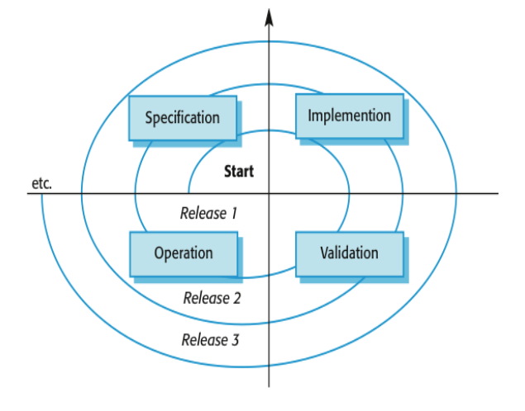
System Evolution
Organizations have huge investments in their software systems - they are critical business assets. To maintain the value of these assets to the business, they must be changed and updated. The majority of the software budget in large companies is devoted to changing and evolving existing software rather than developing new software.
A spiral model of development and evolution represents how a software system evolves through a sequence of multiple release

Slide 4
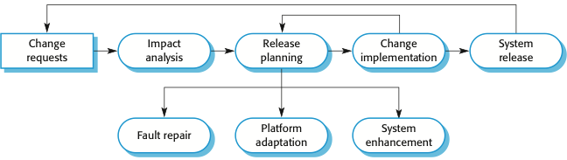
Evolution Process
Software evolution processes depend on:
The type of software being maintained;
The development processes used;
The skills and experience of the people involved.
Notes:
Change Requests:
These could be due to faults, performance improvements, platform updates, or new features.
Impact Analysis:
their effects on the system, including cost, feasibility, and risks.
Release Planning:
scheduled for deployment.
Change Implementation:
This could involve fixing issues, adapting the system to new platforms, or enhancing functionality.
System Release:
The updated system is released to users after testing and validation.
Types of Changes:
The diagram shows three main categories of system changes:
Fault Repair: Fixing errors and bugs.
Platform Adaptation: Updating the system to work on new platforms or hardware.
System Enhancement: Adding new features or improving existing ones.
The first-ever version of Windows needed 10 floppy disks to install! 💾😲
When Windows 1.0 was released in 1985, it required ten 5.25-inch floppy disks for installation. Each disk could only hold about 360 KB of data, which is millions of times less storage than modern computers!
Compare that to Windows 11, which requires around 64 GB of storage—showing just how far system evolution has come in terms of software size and complexity! 🚀🔥

Slide 5
Software Deployment
Software deployment includes all of the steps, processes, and activities that are required to make a software system or update available to its intended users.
Today, most IT organizations and software developers deploy software updates, patches and new applications with a combination of manual and automated processes.
Some of the most common activities of software deployment include software release, installation, testing, deployment, and performance monitoring.

Slide 6
Popular companies for hosting deployments are:
Mercentile
GoDaddy
Himalayan Host
Prabhu Host
Nep clouds
Cloud Himalaya

Slide 7
System Maintenance
The process of monitoring, evaluating, and modifying of existing information systems to make required or desirable improvements may be termed as System Maintenance.
System maintenance is an ongoing activity, which covers a wide variety of activities, including removing program and design errors, updating documentation and test data and updating user support.

Slide 8
Need for Maintenance
Correction of ‘bugs’
Improving opportunities for a changing environment
Remove obsolete functions
Performance improvement
Improve the design.

Slide 9
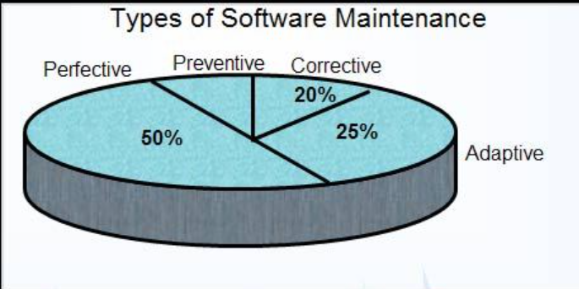
Types of Maintenance:
5%

Slide 10
Corrective Maintenance:
This type of maintenance implies removing errors in a program, which might have crept in the system due to faulty design or wrong assumptions. Thus, in corrective maintenance, processing or performance failures are repaired.
Corrective maintenance of a software product may be essential either to rectify some bugs observed while the system is in use, or to enhance the performance of the system.
Notes:
Real-life Example: In 2015, a popular social media facebook platform experienced a memory leak in their mobile app that affected performance.
As users interacted with the app, their memory consumption increased, causing slower load times and eventually causing crashes.
The bug was traced back to improperly managed image caching and was fixed by optimizing the way images were stored and retrieved.

Slide 11
Adaptive Maintenance:
Modification of a software product performed after delivery to keep a software product usable in a changed or changing environment.
This includes modifications and updates when the customers need the product to run on new platforms, on new operating systems, or when they need the product to interface with new hardware and software.
Notes:
Imagine a financial management software jasko lagi chai new rule haru aayo re suppose that helps businesses track transactions and generate reports. The software was originally developed to meet certain tax regulations, but new tax laws are passed in the country that require changes in how financial data must be reported or stored (for example, stricter data privacy laws like GDPR in the European Union).
To ensure the software continues to be legally compliant, the development team would perform adaptive maintenance, which might involve:
Updating the software to include new data protection features (such as better encryption or user consent tracking).
Modifying report generation features to include the new tax codes or data formatting required by the updated tax laws.
Ensuring data storage compliance by changing how long certain data can be retained and where it is stored.

Slide 12
Perfective Maintenance:
Perfective maintenance means adding new programs or modifying the existing programs to enhance the performance of the information system.
This type of maintenance undertaken to respond to user’s additional needs which may be due to the changes within or outside of the organization.
A software product needs maintenance to support the new features that the users want or to change different types of functionalities of the system according to the customer demands.
Notes:
Consider a video streaming platform that allows users to watch movies and TV shows. Over time, as the platform gains more content and users, some users report slow load times or buffering issues, especially with high-definition (HD) videos.
To improve the user experience, the development team performs perfective maintenance by:
Optimizing video compression algorithms to reduce the buffering time and make video streaming smoother.
Improving the app's caching mechanism to store frequently watched videos locally, reducing the load time for repeated views.
Enhancing the backend infrastructure to support increased traffic and reduce server load during peak usage times.

Slide 13
Preventive Maintenance
Preventive maintenance involves performing activities to prevent the occurrence of errors. It tends to reduce the software complexity thereby improving program understandability and increasing software maintainability.
This type of maintenance includes modifications and updates to prevent future problems of the software. It goals to attend problems, which are not significant at this moment but may cause serious issues in future.
Code optimization involves modifying the programs for faster execution or efficient use of storage space. Code restructuring involves transforming the program structure for reducing the complexity in source code and making it easier to understand.
Notes:
Imagine a web application that stores sensitive customer data, such as credit card information and personal details. The development team identifies a security flaw in the app where SQL injection attacks could be used to access the database and steal customer data.
To perform preventive maintenance, the development team takes the following actions:
Sanitizing user input to prevent malicious SQL queries from being executed by the database.
Implementing stricter authentication protocols to ensure only authorized users can access sensitive areas of the application.
Regularly updating third-party libraries and frameworks to ensure no known vulnerabilities are present.

Slide 14
Types of Maintenance in other words:
1. Fault repairs: Coding errors are usually relatively cheap to correct; design errors are more expensive as they may involve rewriting several program components. Requirements errors are the most expensive to repair because of the expensive system redesign which be necessary.
2. Environmental adaptation: This type of maintenance is required when some aspect of the system’s environment such as the hardware, the platform operating system, or other support software changes the application system must be modified to adapt it to cope with these environmental changes.
3. Functionality addition: This type of maintenance is necessary when the system requirements change in response to organizational or business change .the scale of the changes required to the software is often much greater than for the other types of maintenance.

Slide 15
Why is it difficult to differentiate between the types of maintenance?
In practice, there is not a clear-cut distinction between these types of maintenance, when the system adapt to new environment, then add functionality to take advantage of new environmental features. Software faults are often exposed because users use the system in unanticipated ways. These types of maintenance are recognized but a different person sometimes gives them different names.
‘Corrective maintenance’ is universally used to refer to maintenance for fault repair’
“Adaptive maintenance’ sometimes means adapting to new environment and sometimes means adapting the software to new requirements.
‘Perfective maintenance’ sometimes means perfecting the software by implementing new requirements; in other cases it means maintaining the functionality of the system but improving its structure and performance.
‘Preventive maintenance’ some time means maintenance prediction .

Slide 16
Program evolution dynamics
Program Evolution Dynamics refers to the study of how software programs change and evolve over time. It involves understanding the factors, processes, and patterns that drive the continuous development, adaptation, and maintenance of software systems.
After several major empirical studies, Lehman and Belady proposed that there were a number of 'laws' which apply to all systems as they evolved. There are sensible observations rather than laws. They are applicable to large systems developed by large organizations.
Notes:
Version Control Systems (VCS) – Track and manage code changes (e.g., Git).
Agile Development – Use iterative releases based on user feedback (e.g., Scrum, Kanban).
Continuous Integration/Deployment (CI/CD) – Automate testing and deployment (e.g., Jenkins, CircleCI).
Modular Architecture/Microservices – Break software into smaller, independent services.
Refactoring – Improve code design and performance without changing functionality.
User Feedback/Data-Driven Development – Collect and prioritize features based on user data.
Automated Testing and QA – Ensure code remains functional and bug-free (e.g., unit tests).
Security Management – Regularly update software to address new security threats.
Release Management – Control and plan updates to avoid disruptions.
Documentation and Knowledge Sharing – Keep documentation up to date for easier collaboration and understanding.

Slide 17
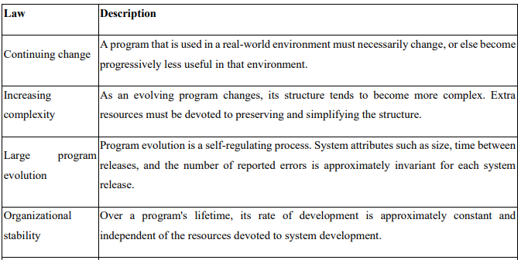
Lehman and Belady’s Law
Notes:
Law of Continuing Change: kunai pani app constantly afno feature haru uptodate garerakhna parxa natra obsolute hunxa
Example: A popular social media app like Instagram constantly updates its features, algorithm, and user interface. This is because user preferences change, new technologies emerge, and competitors introduce innovations. If Instagram didn't adapt, it would become obsolete.
Law of Increasing Complexity: jati evolve vayo tyo anusar complexity ni badhxa
Example: Microsoft Word started as a simple word processor but has evolved into a complex suite with hundreds of features. This added complexity makes it harder to maintain, debug, and improve the software, sometimes leading to bloat and performance issues.
Law of Self-Regulation: profitable vanda ni highest quality software banaune through opensource.
Example: Open-source projects like Linux have a community of developers who self-regulate the evolution of the software. Through discussions, code reviews, and testing, they ensure changes are aligned with the project's goals and maintain its stability.
Law of Organizational Stability: employee lai contract ma rakhne .. Intellectual property kinera rakhne.. Share dine .. Leapfrog le mac dinxa cotiviti le sun ko sikka dinxa
Example: Large companies like Google have established processes and teams dedicated to maintaining their core products like Search. These structures provide stability and consistency in the evolution of the software, even as the company grows and changes.

Slide 18
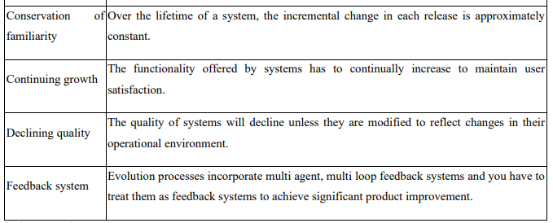
Lehman and Belady’s Law
Notes:
Law of Conservation of Familiarity:
Example: When Facebook redesigned its user interface, there was a backlash from users accustomed to the old design. This illustrates the need to balance innovation with the need to maintain familiarity for users.
Law of Continuing Growth:
Example: Video games like "Grand Theft Auto" release new versions with more content, features, and improved graphics to keep players engaged and attract new customers. This continuous growth is essential for the game's long-term success.
Law of Declining Quality:
Example: Older software systems may suffer from performance issues, security vulnerabilities, and compatibility problems due to accumulated technical debt and lack of maintenance. This highlights the need for continuous maintenance and adaptation to prevent quality decline.
Law of Feedback System:
Example: Companies like Amazon heavily rely on customer reviews, feedback forms, and usage data to understand user needs and guide the evolution of their e-commerce platform.
This feedback loop is crucial for the platform's continuous improvement.

Slide 19
Question
What is System Evolution? Explain with some real world example.
What is System Maintenance? Explain its types.
What is Program Evolution Dynamics? Explain Lehman and Belady’s Law.

Slide 20
Legacy management systems
Legacy management systems are software systems that have been in use for a long time and have become difficult to maintain or update.
These systems often play critical roles in business operations and may contain valuable data, but their outdated technology, architecture, or design can make them challenging to manage and evolve.
Effective management of legacy systems is critical for many organizations, as these systems can have a significant impact on business operations, customer experience, and revenue. Some common challenges of managing legacy systems include:
Notes:
A Legacy Management System refers to outdated software or technology that is still in use within an organization, often because it is critical to operations despite being old, difficult to maintain, or incompatible with modern systems.
Challenges of Legacy Systems
Maintenance Costs – Older systems require expensive upkeep and specialized knowledge.
Security Risks – Legacy systems may lack modern security patches, making them vulnerable.
Compatibility Issues – They often struggle to integrate with new technologies.
Limited Scalability – Older architectures may not support business growth efficiently.
User Experience – Outdated interfaces can reduce productivity and increase training costs.
Strategies for Managing Legacy Systems
Encapsulation – Wrapping the system with APIs to enable integration with modern applications.
Rehosting – Migrating the system to a cloud or virtualized environment without changing the code.
Replatforming – Making minor updates to improve performance while keeping core functionality.
Refactoring – Modifying the internal structure to improve efficiency while maintaining behavior.
Replacement – Phasing out the legacy system in favor of a modern solution.

Slide 21
Legacy management systems
Maintenance: Legacy systems often require a significant amount of effort and resources to maintain, as the technology, programming languages, and frameworks used to develop them may no longer be supported.
Integration: Integrating legacy systems with modern technologies or other systems can be challenging, as these systems may use proprietary data formats or communication protocols.
Security: Legacy systems can be vulnerable to security breaches due to outdated security measures and a lack of support for modern security standards.
Cost: Maintaining and updating legacy systems can be expensive, as the resources required to support these systems may be limited or difficult to find.
Notes:
Banking Systems (Mainframes - COBOL)
Many banks still use COBOL-based mainframe systems from the 1970s and 1980s for core banking operations.
Example: Bank of America & JPMorgan Chase still rely on COBOL for processing transactions.
Challenge: COBOL developers are retiring, making it hard to maintain.
Solution: Banks use APIs to integrate legacy systems with modern mobile banking apps.
Healthcare (NHS Patient Records - UK)
Many hospitals in the UK use legacy Electronic Health Records (EHRs) developed in the 1990s.
Challenge: Difficulty in integrating with new digital health platforms.
Solution: Data migration to cloud-based EHR solutions like Epic and Cerner.
Telecommunications (AT&T, Verizon - SS7 Networks)
The SS7 signaling protocol, developed in the 1970s, is still used for phone call routing globally.
Challenge: Vulnerable to cyberattacks (e.g., location tracking & call interception).
Solution: Telecom companies implement security patches and firewalls while transitioning to 5G networks.

Slide 22
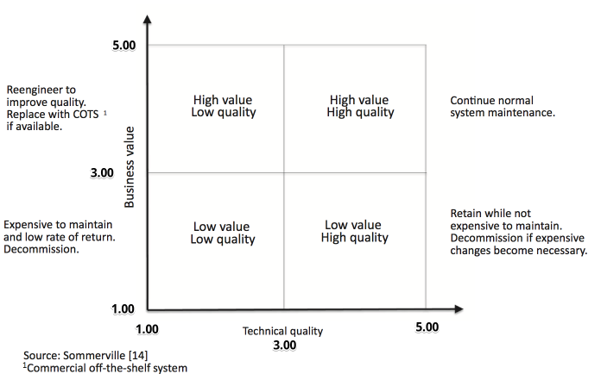
Legacy management systems

Slide 23
Software reengineering
Software reengineering, also known as software reverse engineering or software renovation, is the process of analyzing and modifying existing software systems to improve their functionality, maintainability, and performance.
The goal of software reengineering is to update or improve existing software systems that are no longer effective or have become difficult to maintain. This may involve a range of activities, such as:
Reverse engineering: Analyzing existing software to understand its structure, behavior, and functionality.
Restructuring: Modifying the code structure to make it more modular and easier to maintain.
Refactoring: Improving the code quality by making it more readable, maintainable, and efficient.

Slide 24
Software reengineering
Migration: Moving the software system to a new platform or architecture to improve its performance or scalability.
Re-documentation: Updating the documentation to reflect the changes made during the reengineering process.
Software reengineering is often necessary for legacy software systems that have been in use for many years and have become difficult to maintain or update. By reengineering these systems, developers can improve their functionality, maintainability, and performance, making them more effective and valuable to the organizations that use them.

Slide 25
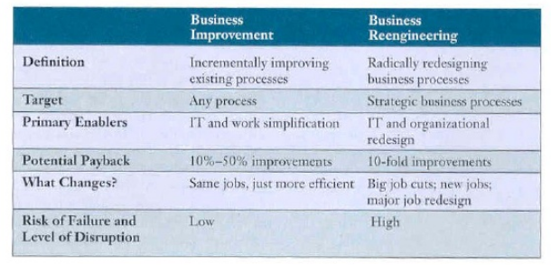
REENGINEERING BUSINESS PROCESSES

Slide 26
One of the most popular competitive strategies today is business process reengineering most often simply called reengineering.
Reengineering is the fundamental rethinking and radical redesign of business processes to achieve dramatic improvements in cost, quality, speed, and service.
Business Process Reengineering (BPR) combines a strategy of promoting business innovation with a strategy of making major improvements to business processes so that a company can become a much stronger and more successful competitor in the marketplace.
The potential payback of reengineering is high, but also is its level of risk and disruption to the organizational environment.

Slide 27
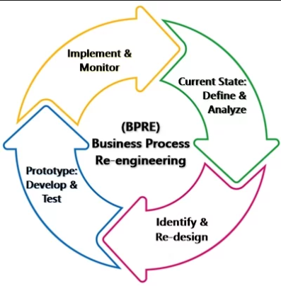
BPR process

Slide 28
The Role of Information Technology
Information technology plays a major role in reengineering business processes.
The speed, information processing capabilities, and connectivity of computers and Internet technologies can substantially increase the efficiency of business processes, as well as communications and collaboration among the people responsible for their operation and management.

Slide 29
IMPROVING BUSINESS QUALITY
No single approach to organizational change is appropriate for all circumstances.
One important strategic thrust is continuous quality improvement, popularly called total quality management (TQM).
Previous to TQM, quality was defined as meeting established standards or specifications for a product or service.
Statistical quality control programs were used to measure and correct any deviations from standards.

Slide 30
Quality Management
Software Quality Management ensures the required level of quality is achieved by submitting improvements to the product development process.
Key Concepts from the Notes
Software Quality Assurance (SQA): Aims to develop a culture within the team where quality is seen as everyone's responsibility and establishes organizational procedures and standards.
Quality Planning: Selects applicable procedures and standards for a particular project and modifies them as required to develop a quality plan.
Quality Control: Ensures that best practices and standards are followed by the software development team to produce quality products.
Core Activities
1) Quality Assurance: Developing organizational procedures and standards for quality at an organizational level.
2) Quality Planning: Selecting and tailoring standards and procedures to create a project-specific quality plan.
3) Quality Control: Monitoring and verifying that the team follows established best practices during development.

Slide 31
Question
What is Legacy management system? Also explain Software Reengineering and its activities.
Differentiate between BPR and BPI.
Write short notes on TQM.

